Slide 1


MECHANICAL MACHINERY
RENTAL AND MANAGEMENT
SYSTEM
PRESENT BY GROUP FA24SE008
Nguyễn Minh Nguyên SE172159 (Leader)
Võ Minh Trí SE172223
Nguyễn Văn Hoàng Minh SE171872
Lý Ngọc Đăng Khoa SE172103
Bùi Nguyễn Phúc Khang SE171990
Mentor: Võ Thị Thanh Vân

Slide 2


CONTEXT
Users need to rent mechanical machinery with detailed specifications and components for each machine.
Traditional companies rely on Excel or paper-based systems to manage rentals, causing difficulties in tracking, assigning technical staff for delivery, and handling machine issues.
During usage, businesses often face machine-related issues, making repair requests and real-time problem-solving complicated, which disrupts operations and impacts rental efficiency.

Slide 3
SOLUTION
Online Rental System
Simple Task Management
Machinery Tracking and Management

Slide 4





MAIN ACTORS
CUSTOMER
MANAGER
WEBSITE STAFF
TECHNICAL STAFF
ADMIN

Slide 5
MAIN ACTORS
CUSTOMER
MANAGER
Manage profile
View machinery
View machinery detail
View machinery component
Manage renting request
Manage machine check request
Manage contract
Manage invoice
Manage address
View delivery list
View contents
Manage profile
View renting request
Manage machine task
Manage delivery task
View contract
Manage staff account
View invoice
Create refund invoice
Manage membership ranking

Slide 6
MAIN ACTORS
WEBSITE STAFF
TECHNICAL STAFF
ADMIN
Manage profile
Manage machinery
Manage machinery component
Manage machinery attributes
Manage content
Manage category
Manage serial machine
Manage machine check criteria
Manage renting service
Manage term
Manage profile
Manage machine task
Manage delivery task
Manage component replacement ticket
Manage account
Manage analytics and reporting

Slide 7
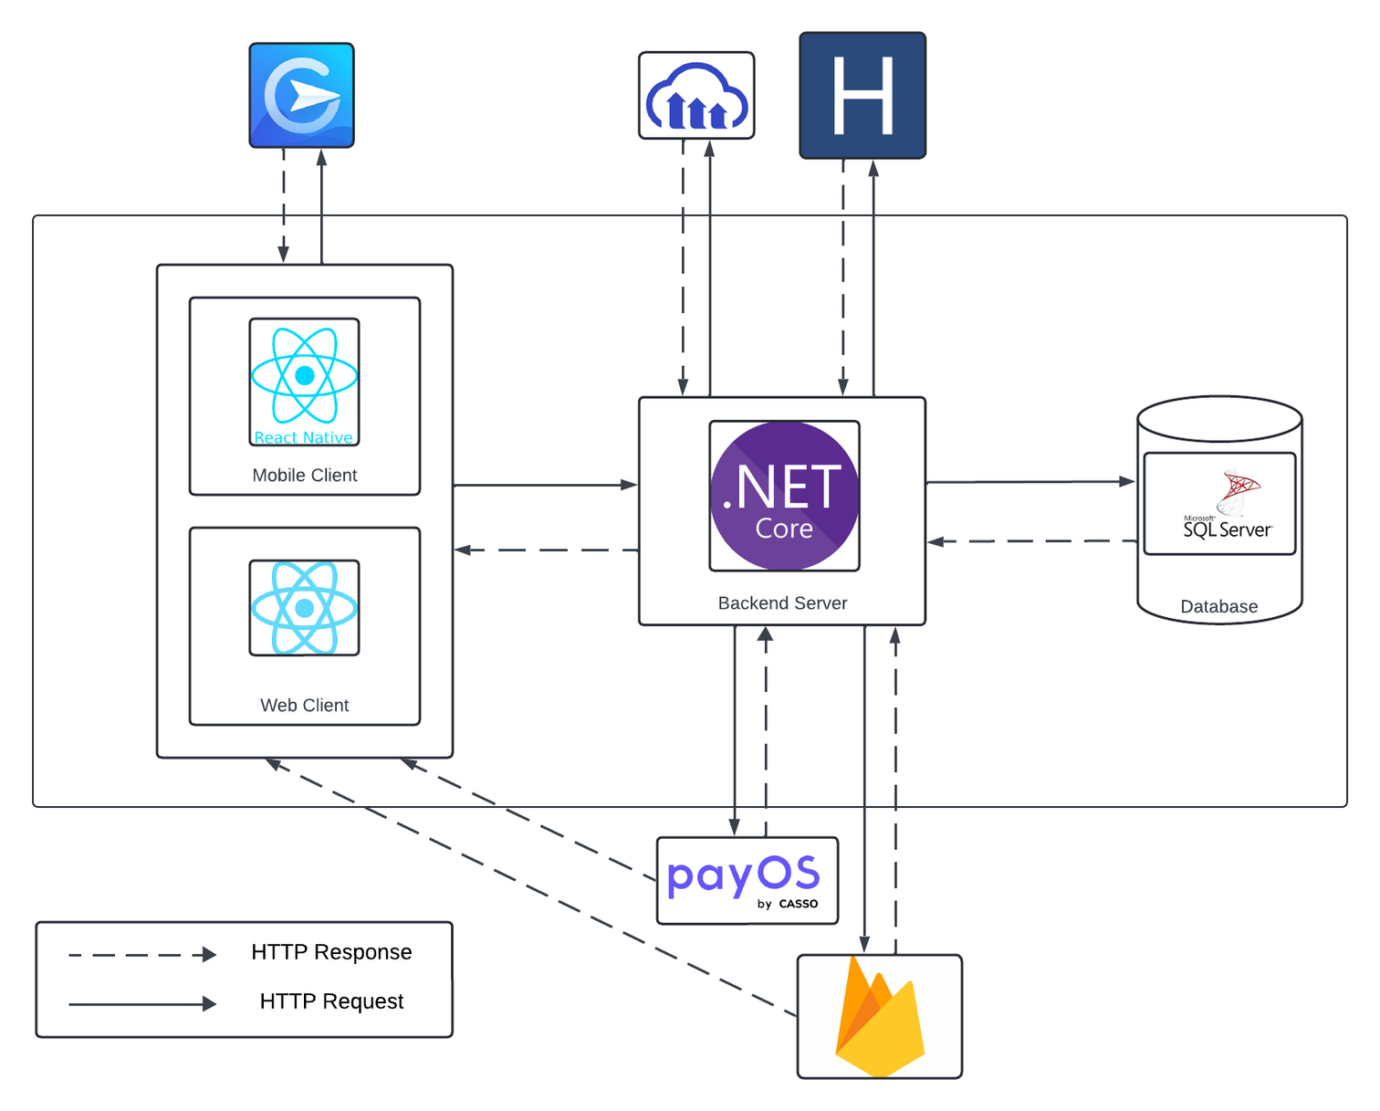
SYSTEM OVERVIEW ARCHITECTURE

Slide 8
MAIN FLOWS
Workflow 1. Machinery and Component Management
Workflow 2. Rent and Deliver Mechanical Machineries
Workflow 3. Check Mechanical Machineries
Workflow 4. End and Extend Contract

Slide 9

MACHINERY AND COMPONENT MANAGEMENT
WEBSITE STAFF
Create machine
Create serial number

Slide 10









MACHINERY AND COMPONENT MANAGEMENT
View list of
machinery
Login
Search machine
WEBSITE STAFF
View list of
component
Add new machine
Search component
Create new
component
Create new
component
Add
component
Add new
serial number
View machine
Notes:
Cần giới thiệu đặc thù của 1 máy cơ khí rồi mới mô tả luồng này

Slide 11
RENT AND DELIVER MECHANICAL MACHINERIES
CUSTOMER
MANAGER
TECHNICAL STAFF
Create renting request
Create delivery task
Delivery machines
Pay rental invoice
Complete delivery task

Slide 12













RENT AND DELIVER MECHANICAL MACHINERIES
Chose machine to rent
Customer reviews contract
Customer create renting request
Create contract
CUSTOMER
MACHINERIES
SYSTEM
CONTRACT
View delivery task
Create Delivery Task
Customer pay rental invoice
Notify
TASK
TECHNICAL
STAFF
MANAGER
Staff Deliver
Machines
Complete delivery task
Contract Renting
CONTRACT

Slide 13
CHECK MECHANICAL MACHINERIES
CUSTOMER
MANAGER
TECHNICAL STAFF
Request check machine
Create check machine task
Create component replacement ticket
Pay ticket fee
Finish ticket replace component
Finish task check machinery

Slide 14










CHECK MECHANICAL MACHINERIES
Request check machine
Notify
View request list
View detail
CUSTOMER
MANAGER
Notify
Create task
View task
Check machine
TECHNICAL
STAFF
Find broken component
Create component replacement ticket
Notify
Pay fee
No component need replacement
CUSTOMER
Notify
Finish task check machinery
Replace component
TECHNICAL STAFF

Slide 15
END AND EXTEND CONTRACT
CUSTOMER
MANAGER
STAFF
End Contract
Create check machine task
Create component replacement ticket
Extend Contract
Create refund invoice
Finish task check machinery

Slide 16

END AND EXTEND CONTRACT
Choose contract and confirm end
Create task check machine
Notify
Notify
CUSTOMER
CONTRACT
MANAGER
TASK
TECHNICAL STAFF
Check machine
Staff completes task
Contract complete
Creates and pay refund invoice
Notify
CONTRACT
INVOICE
MANAGER
TASK
MACHINE
Choose contract and confirm
extend
System creates extend contract
Extend
complete
Pay rental
invoice
CUSTOMER
CONTRACT
CONTRACT
CONTRACT

Slide 17


CONCLUSION AND LIMITATIONS
Enhanced teamwork and project management through successful collaboration.
Improved problem-solving skills and overall field competency.
Unprofessional user interface.
Lacks support for handling damaged, non-repairable rental machines.

Slide 18
ACKNOWLEDGEMENT
Grateful to FPT University lecturers for their guidance.
Appreciation to the reviewers for their valuable feedback.

Slide 19

Thank you for your time and attention!
Q & A

